Slide 1

DIGITAL DESIGN AND COMPUTER ORGANIZATION
Number, Arithmetic Operations, And Characters
Memory Locations And Address T2: Chapter 2: 2.1-2.2
Department of Computer Science and Engineering

Slide 2
Number, Arithmetic Operations, And Characters Outline
Number Representation
Addition of Positive Numbers
Addition And Subtractions of Signed Numbers
Overflow In Integer Arithmetic
Characters

Slide 3
DIGITAL DESIGN AND COMPUTER ORGANIZATION
1. Number Representation T2:Ch2 2.1
Department of Computer Science and Engineering

Slide 4
Number, Arithmetic Operations, And Characters Introduction(T2- section 2.1)
Programming languages are classified into three categories: Machine Level Language (MLL), Assembly Level Language (ALL), and High Level Language (HLL)
ALL- readable representation of MLL
Computers are built using logic circuits that operate on information represented by two- valued electrical signals . We label the two values as 0 and 1
we define the amount of information represented by such a signal as a bit of information, where bit stands for binary digit.
The most natural way to represent a number in a computer system is by a string of bits, called a binary number.
A text character can also be represented by a string of bits called a character code.
Notes:
HLL-ALL-MLL

Slide 5
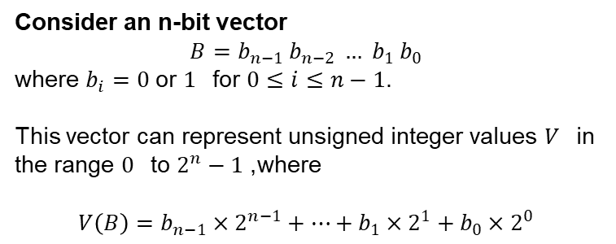
Number Representation-signed and unsigned Signed Integer
Consider an n-bit vector
$$B=b_{n−1} b_{n−2} … b_{1} b_{0}$$
where $b_{i}=0$ or $1$for $0≤i≤n−1$.
This vector can represent unsigned integer values $V$in the range $0$to $2^{n}−1$, where
$$V\left(B\right)=b_{n−1}×2^{n−1}+⋯+b_{1}×2^{1}+b_{0}×2^{0}$$

Slide 6
Number Representation-signed and unsigned Signed Integer
3 major representations:
Sign and magnitude
One’s complement
Two’s complement
In all three systems, the leftmost bit is 0 for positive and 1 for negative
Positive numbers have identical representations in all systems, but negative values have different representations
Example:
4-bit machine word
16 different values can be represented
Roughly half are positive, half are negative

Slide 7
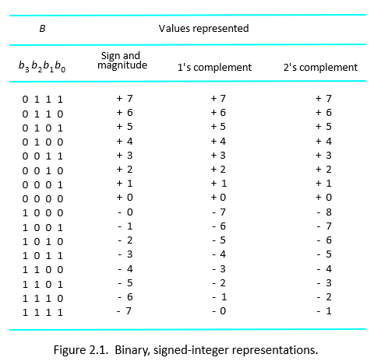
Number Representation Binary Signed Integer Representation

Slide 8
Number Representation Summary of the table
SIGN & MAGNITUE SYSTEM: Negative value is obtained by changing the sign bit (MSB)
Range: -(2^{n-1} ) -1 to +2^{n-1} -1
SIGNED 1’S COMPLEMENT: Negative number is obtained by complementing each bit of the corresponding positive number i.e (2^{n}-1) –N
Range: -(2^{n-1} ) -1 to +2^{n-1} -1
SIGNED 2’S COMPLEMENT: Negative number is obtained by taking 2’s complement of positive number i.e 2^{n}-N
Range: - (2^{n-1}) to + (2^{n-1}-1)

Slide 9
Addition of Positive Number T2:Ch2 2.1
0 1 0 1
+ 0 + 0 + 1 + 1
------ ------- ------- --------
0 1 1 1 0
------ -------- -------- --------
Addition of 1-bit numbers
Carry-out

Slide 10
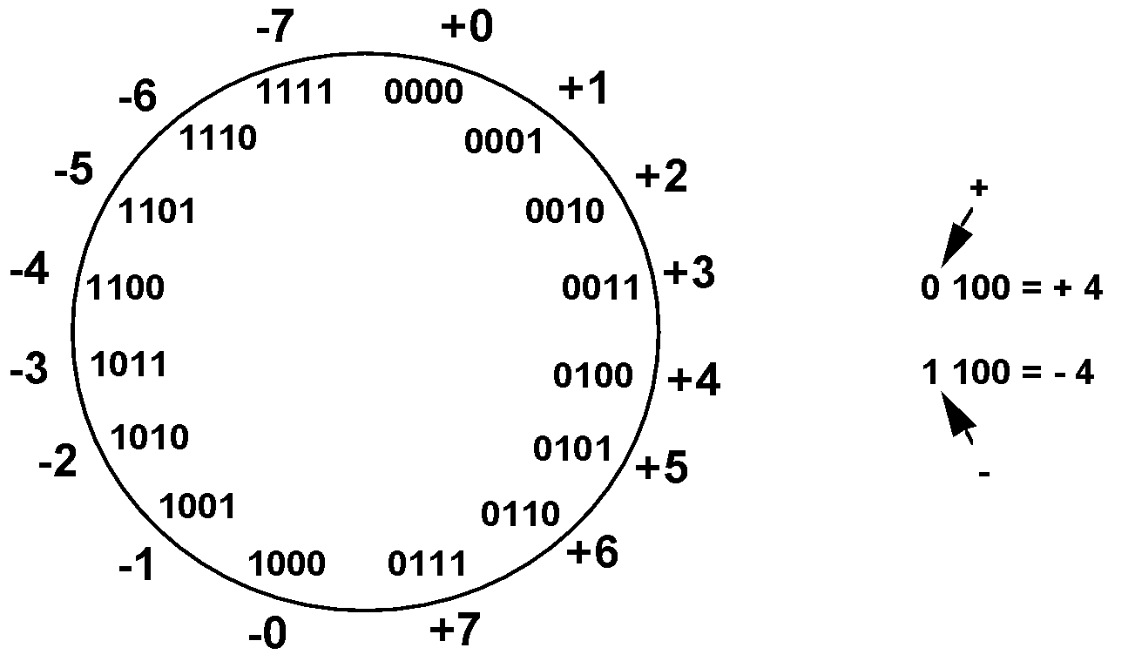
Addition And Subtraction of Signed Numbers Sign and Magnitude Representation T2:Ch2 2.1
High order bit is sign: 0 = positive (or zero), 1 = negative
Three low order bits is the magnitude: 0 (000) thru 7 (111)
Range = -(2^{n-1} )-1 to +2^{n-1} -1
Two representations for 0

Slide 11

Addition And Subtraction of Signed Numbers One’s Complement Representation
In 1’s complement -ve value is obtained by complementing each bit of the corresponding +ve value
The operation of forming 1’s complementing is equivalent to subtracting that no. from 2^{n} -1
Still two representations of 0! This causes some problems

Slide 12
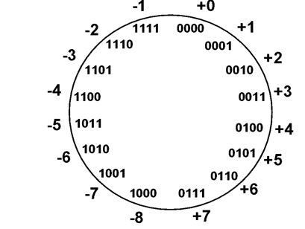
Addition And Subtraction of Signed Numbers Two’s Complement Representation
Modulo 16 for 2’s complement representation
The operation of forming 2’s complementing is equivalent to subtracting that no. from 2^{n}
2’s complement of a no. can be obtained by adding 1 to the 1’s complement of that no.
Only one representation for 0
One more negative number than positive number
Notes:
-2+4

Slide 13
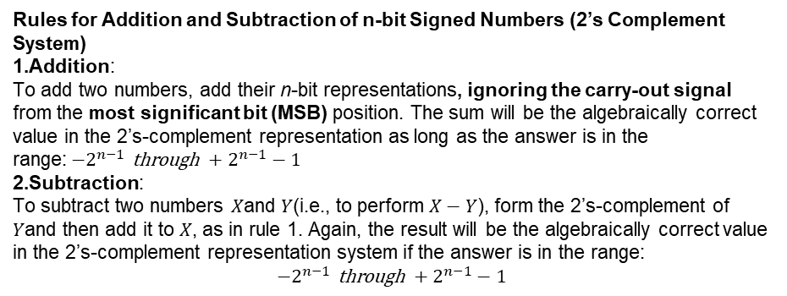
Addition And Subtraction of Signed Numbers Importat Points
Rules for Addition and Subtraction of n-bit Signed Numbers (2’s Complement System)
Addition: To add two numbers, add their n-bit representations, ignoring the carry-out signal from the most significant bit (MSB) position. The sum will be the algebraically correct value in the 2’s-complement representation as long as the answer is in the range:$−2^{n−1} \text{through} +2^{n−1}−1$
Subtraction: To subtract two numbers $X$and $Y$(i.e., to perform $X−Y$), form the 2’s-complement of $Y$and then add it to $X$, as in rule 1. Again, the result will be the algebraically correct value in the 2’s-complement representation system if the answer is in the range:
$$−2^{n−1} \text{through} +2^{n−1}−1$$

Slide 14
Addition And Subtraction of Signed Numbers
For signed arithmetic operations 2’s complement format is used
For signed arithmetic operation sign and magnitude and 1’s complement format is not suitable
To represent signed number in 2’s complement using larger number of bits repeat the sign as many times needed which is called sign extension

Slide 15
Addition And Subtraction of Signed Numbers Addition using 2’s Complement
0111
+ 1101
---------
0100
--------
The carry out should be ignored
1

Slide 16
Example of addition of n – bit signed numbers using 2’s complement representation
+2 0010 +4 0100
+3 + 0011 -6 +1010
---- ---------- ----- ---------
+5 0101 -2 1110
---- ---------- ----- ----------
-4 1100 -6 1010
-3 + 1101 +3 + 0011
--- -------- ---- --------
-7 1001 -3 1101
--- ---------- ---- ---------
1

Slide 17
Example of subtraction of n – bit signed numbers using 2’s complement representation
+4 0100 0100
- +3 - 0011 + 1101
------------ -------- ---------
+1 0001
------------ ---------
+5 0101 0101
-2 - 1110 + 0010
------- --------- --------
+7 0111
-------- ---------
1

Slide 18
Example of subtraction of n – bit signed numbers using 2’s complement representation
-3 1101 1101
-6 - 1010 +0110
------------ -------- -------
+3 0011
------------ ---------
-4 1100 1100
+2 - 0010 + 1110
------- --------- --------
-6 1010
-------- ---------
1
1

Slide 19
Example of addition and subtraction of n – bit signed numbers using 2’s complement representation leading to overflow
+3 0011 0011
- 6 - 1010 🡺 + 0110
------------ -------- ---------
+9 1001 🡺 -7
------------ ---------
-4 1100
+ -5 + 1011
------- --------
-9 1 0111 🡺 +7
-------- ---------

Slide 20
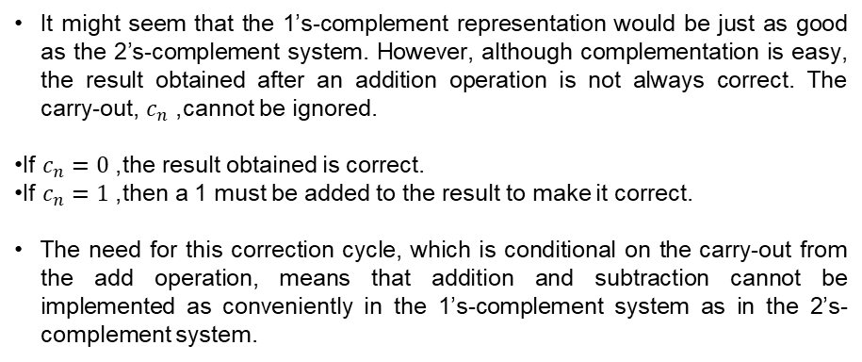
Summary
It might seem that the 1’s-complement representation would be just as good as the 2’s-complement system. However, although complementation is easy, the result obtained after an addition operation is not always correct. The carry-out, $c_{n}$, cannot be ignored.
If $c_{n}=0$, the result obtained is correct.
If $c_{n}=1$, then a 1 must be added to the result to make it correct.
The need for this correction cycle, which is conditional on the carry-out from the add operation, means that addition and subtraction cannot be implemented as conveniently in the 1’s-complement system as in the 2’s-complement system.

Slide 21
Overflow In Integer Arithmetic T2:Ch2 2.1
When result of arithmetic operation is outside representable range, arithmetic overflow has occurred.
Overflow will not occur when two numbers having opposite signs added
Overflow can occur only if two numbers having same signs are added
The carry out signal from the sign bit position is not a sufficient indicator of overflow when adding signed numbers
A simple way to detect the overflow is to examine the signs of the two numbers X and Y and the sign of the result. When both the operands X and Y have the same sign, an over flow occurs when the sign of S is not the same as the signs of X and Y

Slide 22
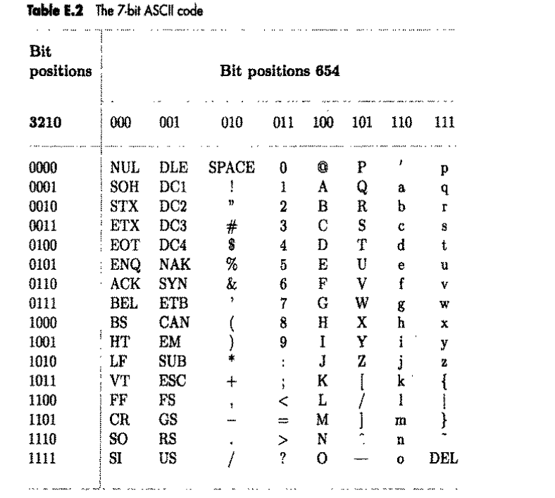
Characters T2:Ch2 2.1
In addition to numbers, computers must be able to handle nonnumeric text information consisting of characters.
Characters can be letters of the alphabet, decimal digits, punctuation marks, and so on.
They are represented by codes that are usually eight bits long. One of the most widely used such codes is the American Standards Committee on Information Interchange (ASCII) code

Slide 23
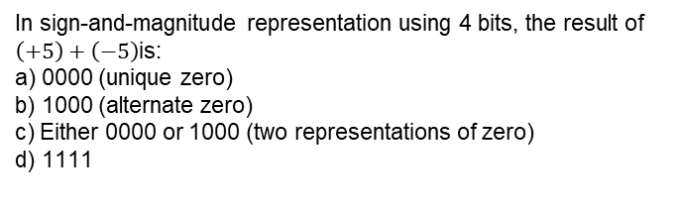
MCQ
In sign-and-magnitude representation using 4 bits, the result of $\left(+5\right)+\left(−5\right)$is:
a) 0000 (unique zero) b) 1000 (alternate zero) c) Either 0000 or 1000 (two representations of zero) d) 1111

Slide 24
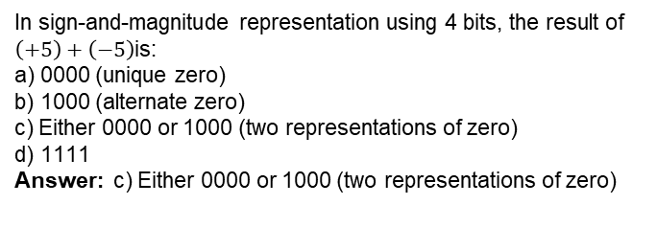
MCQ
In sign-and-magnitude representation using 4 bits, the result of $\left(+5\right)+\left(−5\right)$is:
a) 0000 (unique zero) b) 1000 (alternate zero) c) Either 0000 or 1000 (two representations of zero) d) 1111
Answer: c) Either 0000 or 1000 (two representations of zero)

Slide 25
MCQ
Which of the following statements about overflow in signed integer arithmetic is correct?
Overflow can occur when adding two numbers of opposite signs. b) Overflow occurs when carry-out from MSB is 1. c) Overflow occurs when adding two numbers of same sign and the result has opposite sign. d) Overflow occurs when sign extension is applied.

Slide 26
MCQ
Which of the following statements about overflow in signed integer arithmetic is correct?
Overflow can occur when adding two numbers of opposite signs. b) Overflow occurs when carry-out from MSB is 1. c) Overflow occurs when adding two numbers of same sign and the result has opposite sign. d) Overflow occurs when sign extension is applied.
Answer: c) Overflow occurs when adding two numbers of same sign and the result has opposite sign.

Slide 27
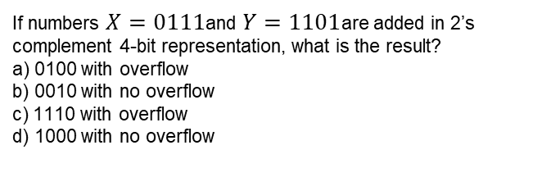
MCQ
If numbers $X=0111$and $Y=1101$are added in 2’s complement 4-bit representation, what is the result?
a) 0100 with overflow b) 0010 with no overflow c) 1110 with overflow d) 1000 with no overflow

Slide 28
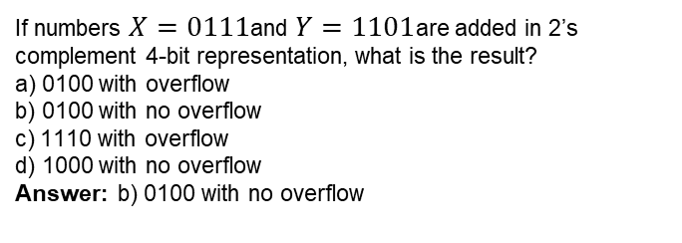
MCQ
If numbers $X=0111$and $Y=1101$are added in 2’s complement 4-bit representation, what is the result?
a) 0100 with overflow b) 0100 with no overflow c) 1110 with overflow d) 1000 with no overflow
Answer: b) 0100 with no overflow

Slide 29
THANK YOU
Team DDCO
Department of Computer Science

